Slide 1

Mini Project Synopsis on:
IMPROVISATION OF CHEST RADIOGRAPH
CLASSIFICATION USING
DIMENSIONALITY REDUCTION
Presented By:
Bishant Raaj Bhujel (202000224)
Mayal Punu Lepcha (202000283)
Rinchen Tempa Bhutia (202000117)
B.Tech, CSE, 6th Semester
Under the supervision of:
Mr. Ashis Pradhan
DEPARTMENT OF COMPUTER SCIENCE AND ENGINEERING
SIKKIM MANIPAL INSTITUTE OF TECHNOLOGY

Slide 2
TABLE OF CONTENTS
SL. NO | CONTENT | SLIDE NO
1. | Abstract | 3
2. | Introduction | 4
3. | Literature Survey | 5-6
4. | Problem Definition | 7
5. | Solution Strategy | 8-9
6. | Design Diagrams | 10-12
7. | Gantt Chart | 13
8. | References | 14

Slide 3
ABSTRACT
The Covid-19 pandemic has highlighted the need for efficient and effective diagnostic tools to assist medical professionals. Chest radiographs can be one such diagnostic tool that can be used to detect the presence of a variety of lung diseases.
However, the high dimensionality of CXR images presents a problem. Our project aims to build a chest radiograph classifier to predict various lung diseases while addressing the issue of high dimensionality by using dimensionality reduction algorithms to extract the most relevant features.
The proposed classifier aims to improve both the accuracy of disease classification and the computational efficiency of the model, making it cost effective and hence practical for real-world applications.

Slide 4
INTRODUCTION
Chest radiographs (chest X-rays), are a valuable diagnostic tool that is widely used to detect the presence of a variety of lung diseases. They are fast to obtain, easily accessible, and relatively inexpensive, making them an ideal tool for screening and diagnosis.
Chest radiograph classifier can be an effective diagnostic tool that can be used in detecting and classifying lung infections such as Covid -19, Pneumonia & Tuberculosis and hence can assist doctors in interpreting Chest X-Rays.
Dimensionality reduction is a technique used to reduce the number of features or dimensions in a dataset, while simultaneously preserving the most important information in the data.

Slide 5
LITERATURE SURVEY
Sl. No | Author (s) | Paper and Publication | Findings | Relevance
1. | Tawsifur Rahman, Amith Khandakar, Yazan Qiblawey, Anas Tahir. | “Exploring the effect of image enhancement techniques on COVID-19 detection using chest X-ray images” Computers in Biology and Medicine 132, Elsevier. [4th March 2021] | Study confirmed that deep learning models can be used to effectively detect lung diseases from CXR images. | Dataset being used was produced by this research.
2. | Thet Thet Khaing, Phyu Sin Nyein, Myint Soe Khyaing, Khaing Khaing Wai | “Dimension Reduction of Images Using Principal Component Analysis Algorithm” Iconic Research and Engineering Journals [May 2020] | Study found that PCA effectively reduced the file size of the images and improved the processing time for the compressed images. | Provides algorithm for applying PCA to images.

Slide 6
Sl. No | Author (s) | Paper and Publication | Findings | Relevance
3. | Ayesha, Shaeela; Hanif, Muhammad Kashif | “Overview and Comparative Study of Dimensionality Reduction Techniques for High Dimensional Data” Information Fusion [Jan 2020] | Study found that Linear DRA techniques are less computationally intensive. | Discusses and compares various dimensionality reduction techniques.
4. | Taufit Rahmat, Azlan Ismail, Sharifah Aliman | “Chest X-Rays Image Classification in Medical Image Analysis” Universiti Teknologi, Malaysia. [27th December 2018] | Study discusses approaches for classifying chest X-ray images, including the classification problem types, datasets used, splitting ratios, methods, and evaluation metrics. | Discusses various approaches for CXR Classification.

Slide 7
PROBLEM DEFINITION
• The demand for efficient diagnostic tools has become increasingly pressing due to the growing burden on healthcare systems, shortage of healthcare workers, and limited resources. Developing effective diagnostic tools can improve the speed and accuracy of diagnoses, reduce the workload on healthcare professionals, and ultimately improve patient outcomes.
• The problem of high dimensionality in chest radiograph images is a significant challenge in the classification of lung diseases and image classification models in general, resulting in lower accuracy, higher computational costs, and potential limitations in real-world applications.

Slide 8
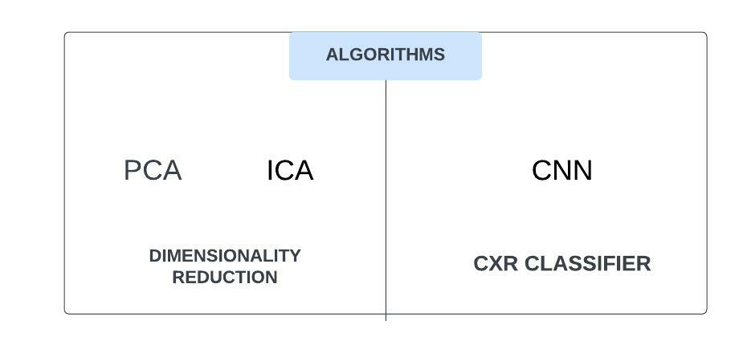
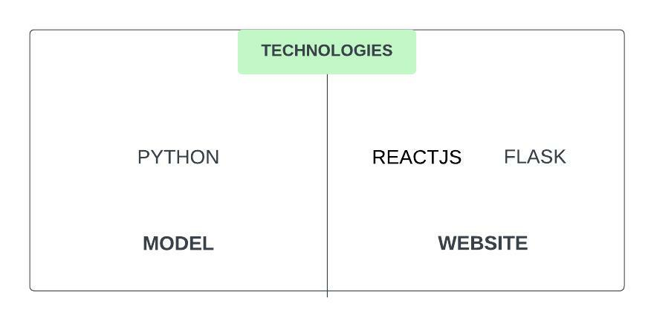
SOLUTION STRATEGY
GOAL: Develop efficient chest x-ray classifier using dimensionality reduction and deploy it in a web app.
STEP 1: Download annotated CXR dataset.
STEP 2: Preprocess data with resizing and splitting.
STEP 3: Use dimensionality reduction algorithms (PCA/ICA)
STEP 4: Train a machine learning model on reduced-dimensionality data
STEP 5: Deploy model on web application using Flask and ReactJS.

Slide 9
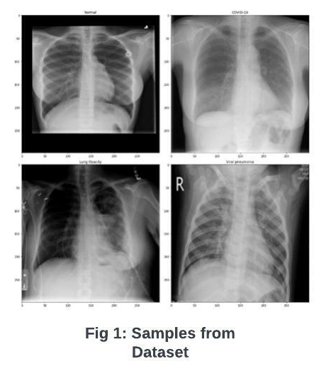
1345

Slide 10
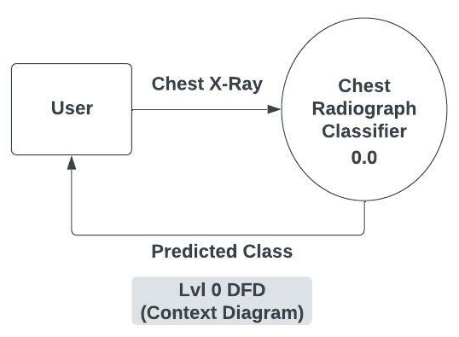
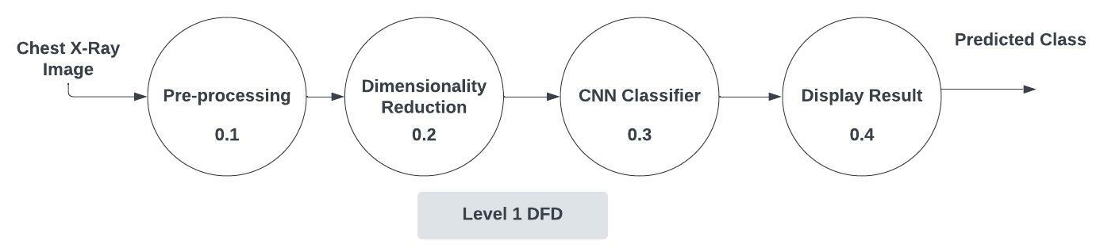
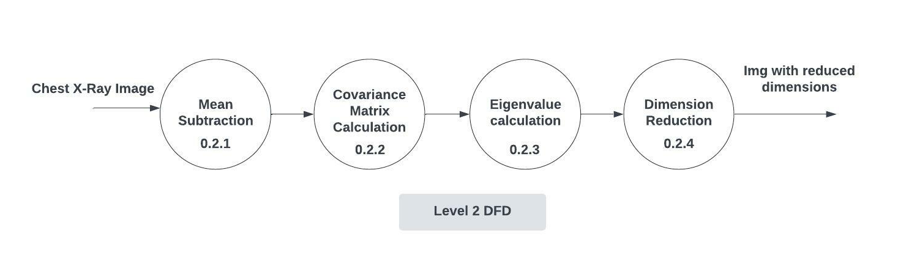
DESIGN DIAGRAMS
DATA FLOW DIAGRAMS

Slide 11
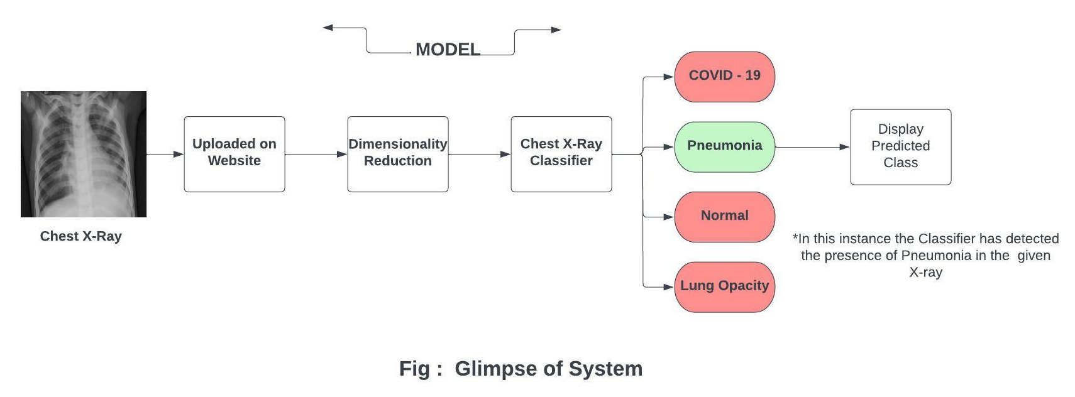
SYSTEM FLOW

Slide 12

WEBSITE DESIGN

Slide 13
GANTT CHART
ACTIVITY | December 2022 | January 2023 | February 2023 | March 2023 | April 2023
Literature Survey
Problem Definition
Design and Development
Testing and Validation
Documentation
 | Proposed Work
 | Completed Work
 | Ongoing Work

Slide 14
REFERENCES
[1] Tawsifur Rahman, Amith Khandakar, Yazan Qiblawey, Anas Tahir, “Exploring the effect of image enhancement techniques on COVID-19 detection using chest X-ray images”,
[March 2021]
Link: https://www.sciencedirect.com/science/article/pii/S001048252100113X
[2] Thet Thet Khaing, Phyu Sin Nyein, Myint Soe Khyaing, Khaing Khaing Wai, “Dimension Reduction of Images Using Principal Component Analysis Algorithm “,
[May 2020]
Link: https://www.irejournals.com/formatedpaper/1702269.pdf
[3] Ayesha, Shaeela; Hanif, Muhammad Kashif, “Overview and Comparative Study of Dimensionality Reduction Techniques for High Dimensional Data”,
[January 2020]
Link: https://www.sciencedirect.com/science/article/abs/pii/S156625351930377X
[4] Taufit Rahmat, Azlan Ismail, Sharifah Aliman, “Chest X-Rays Image Classification in Medical Image Analysis”
[December 2018]
Link:https://www.researchgate.net/publication/330105218_CHEST_XRAYS_IMAGE_CLASSIFICATION_IN_MEDICAL_IMAGE_ANALYSIS

